Slide 1


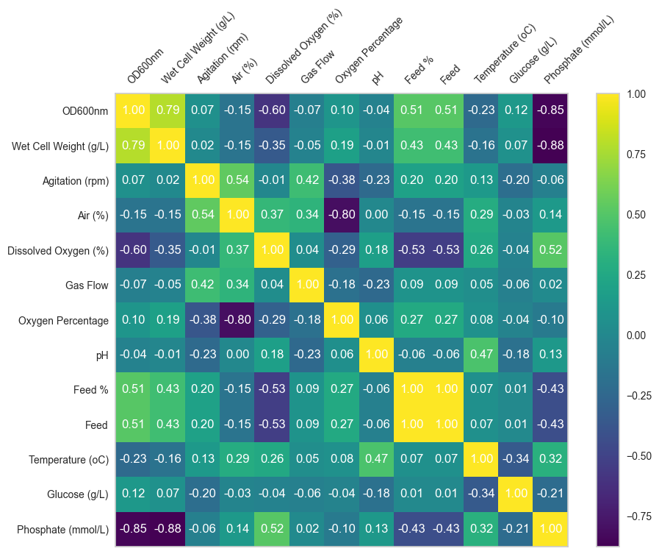
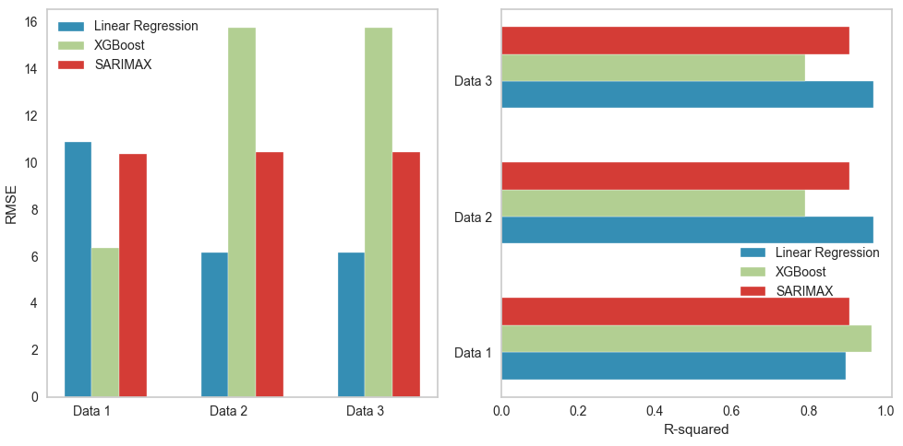
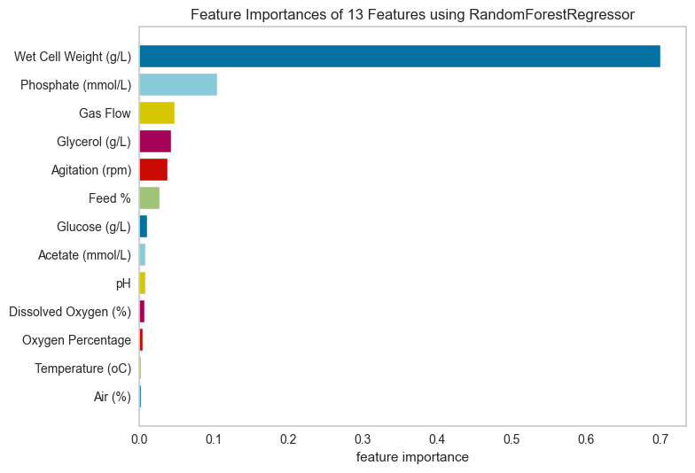
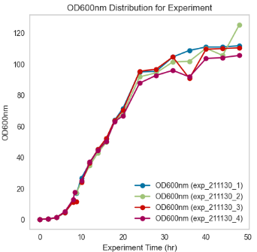
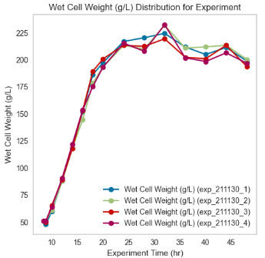
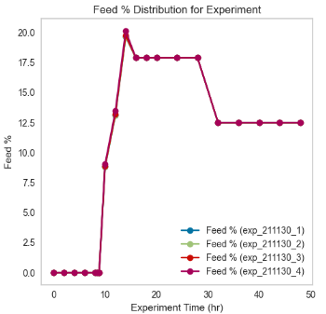
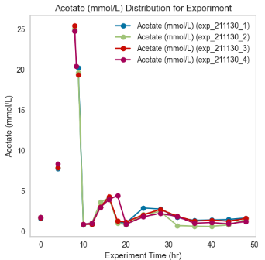
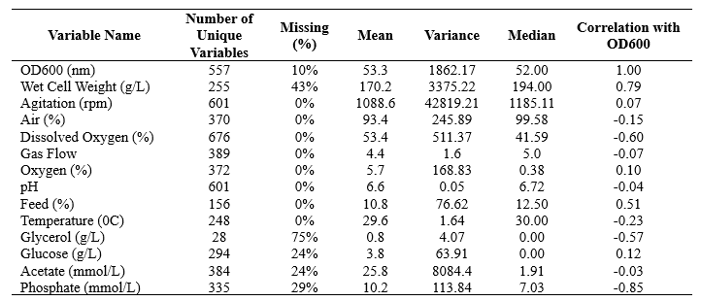
Optimizing Recombinant Protein Titer Production in Escherichia Coli Fermentations Using Interpretable Machine Learning
Paul Okafor¹, Talayeh Razzaghi^{1,2*}
¹Data Science and Analytics Institute, ²School of Industrial and Systems Engineering, University of Oklahoma, Norman, Oklahoma
Background
Feature Analysis through Correlation Analysis and Ranking
Results
Escherichia coli (E. coli) in Biotechnology: E. coli is a preferred host in biotechnological applications due to its rapid growth and simple nutritional requirements. Its use spans a wide range of applications, from pharmaceuticals to industrial enzymes, owing to its ease of genetic manipulation and cost-effective cultivation.
Problem Definition
Optimization Challenges: Achieving optimal protein expression in E. coli is complex, especially for proteins requiring specific conditions or prone to aggregation, presenting significant challenges.
Limitations of Traditional Approaches: Traditional optimization strategies, which are largely based on human expert opinion, struggle to efficiently manage the myriad of fermentation variables, such as temperature, pH, and nutrient levels, leading to suboptimal yields and inefficiencies.
Innovative Approach with ML: This research aims at the integration of interpretable machine learning models into decision support system, specifically designed to unravel the complexities of fermentation dynamics, enabling more precise and efficient optimization.
Data 1: The complete dataset;
Data 2: Excludes high-agitation batches and those with excessive missing values.
Data 3: Removes all batches from 220329_C2 due to missing data.
Feature Importance using Random Forest Regressor
XGBoost excels in Data 1 with the lowest RMSE and highest R², showcasing its superior predictive accuracy.
Linear Regression demonstrates strong performance in Data 2 and Data 3, achieving the lowest RMSE and high R² scores, indicating its effectiveness in these datasets.
SARIMAX shows consistent performance across all datasets but does not lead in RMSE or R² for any, suggesting it has room for improvement compared to the other models.
Fermentation Process Time-Series Analysis
Data
Conclusion
The dataset includes various experiments conducted by Cytovance Biologics, eencompasses a wide array of variables critical to the fermentation process, within the bioreactor environment (n=684). All experiment spans 48 production hours, starting data collection from day 3 onwards. OD600 is the primary outcome of interest.
Our ongoing research into E. coli fermentation has yielded promising strategies for enhancing recombinant protein titer production.
By optimizing fermentation conditions, we have achieved significant improvements in protein yield, underlining the efficacy of our approach. These preliminary results show promise for advancing biotechnological methods.
References
Bonanni, D., Litrico, M., Ahmed, W., Morerio, P., Cazzorla, T., Spaccapaniccia, E., Cattani, F., Allegretti, M., Beccari, A.R., Del Bue, A. and Martin, F., 2023. A Deep Learning Approach to Optimize Recombinant Protein Production in Escherichia coli Fermentations. Fermentation, 9(6), p.503.
Acknowledgement
The authors would like to thank Cytovance Biologics for their generous contribution of biomanufacturing datasets and their close collaboration during the research project. The authors are further grateful for the support by “OKC ED Fd: OU Biotech Core Facility”, Oklahoma City Chamber of Commerce, U.S. Economic Development Administration (Award #: 08-79-05677).

